Slide 1
DSL BASED APPROACH TO API MISUSE DETECTION
Krishna Narasimhan

Slide 2
Agenda
API misuses (Seriousness, Challenges)
Existing approaches (Documentation/ Static Analysis)
DSLs to the rescue (CrySL, JGuard)
Types of misuses supported
Static approach (CrySL)
Dynamic approach (JGuard)
Demo (jGuard)
Notes:
Here is how the agenda for today looks like. The main goal of these slides is mainly to narrow the scope of discussion on API misuses (which can be quite broad as a topic) before we see the DSL in action. As you can see here there are actually a couple of DSLs. Essentially one DSL for a static approach and another for a dynamic approach because API misuse detection requires both variants. Today I will mainly focus on the dynamic DSL part for the demo.

Slide 3
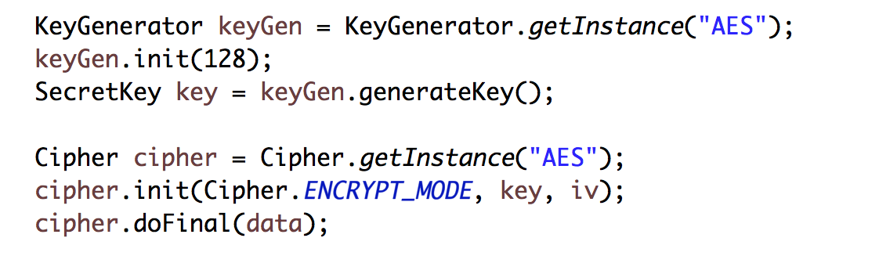
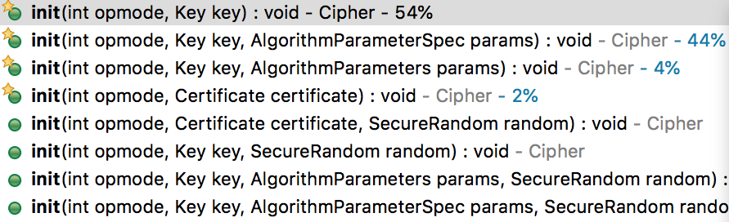
Challenges
API misuse =* any unintended incorrect or potentially dangerous uses of an API
that would not be caught by the compiler.
56, 128, 192, 256, 512, 1024, 2048, 4096, …
AES, DES, Blowfish, …
AES, DES, Blowfish, …
Notes:
Roughly by API misuse, I mean here any unintended wrong or potentially dangerous uses of an API that would not be caught by the compiler.
It’s a rather simplified definition, but it works for now. For the running example I will use snippets from the JCA, the standard cryptogtaphy library. For two reasons, one the original work was inspired by a survey of difficulties faced by crypto developers in using said APIs, and I think it also drives the point home better on why these matter.
The semantics of the domain are not that important. On a high level, the Cipher is object that helps you perform the encryption and decryption and you need to setup a few things before like this SecretKey and stuff. There is like multiple places one could create issues that will pass the compilers. And believe it or not, it is not very common practice to write tests for third party library use code. That was also sort of the motivation for this work, a previous work that studied how people use these security libraries and some survey with the developers asking their pain points, and api misuse came up quite a bit for those using these crypto libraries.
The keygenerator needs an algorithm and yes it is not an enum or anything, just a string parameter in the standard java crypto library. I am not sure if it has changed now. The definition of a secure key length is up for a lot of debate. And actually differen certifying bodies have different definitions too. And the last one is a more brain freeze programmer moment, but it could happen. You don’t use the right mode even if It is an enum.

Slide 4
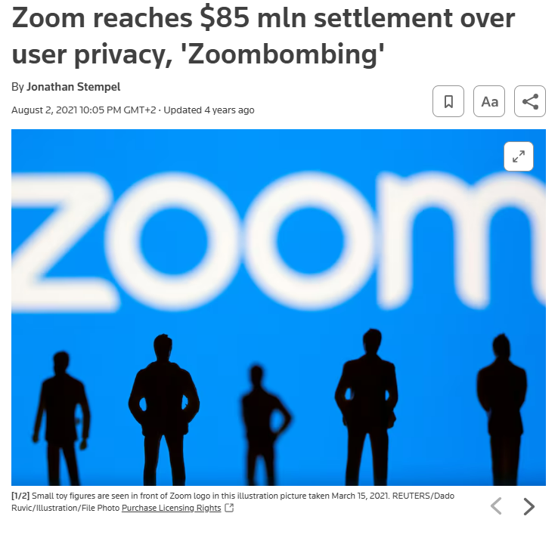
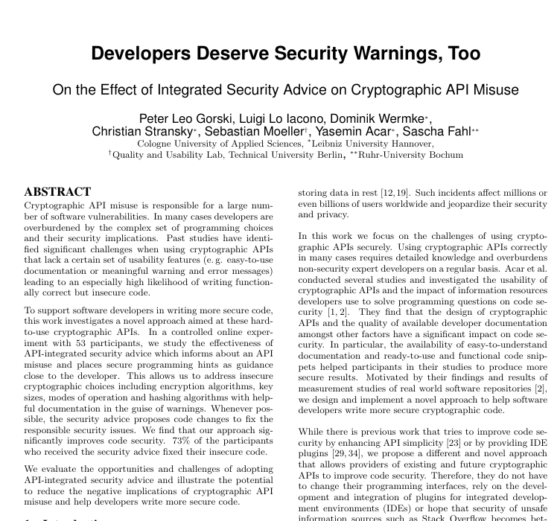
Seriousness
Notes:
These mistakes end up being costly. There are some studies on this but the misuse you saw about the wrong algorithm. Zoom did not obviously reveal their code but mentioned it was because of some mess up between their inhouse crypto libraries and the java ones and even though they claimed to use AES 256 algorithm, their code was using AES 128. I missed the old slides, but I had some examples with Norton security. These kind of things are not uncommon is the point.

Slide 5
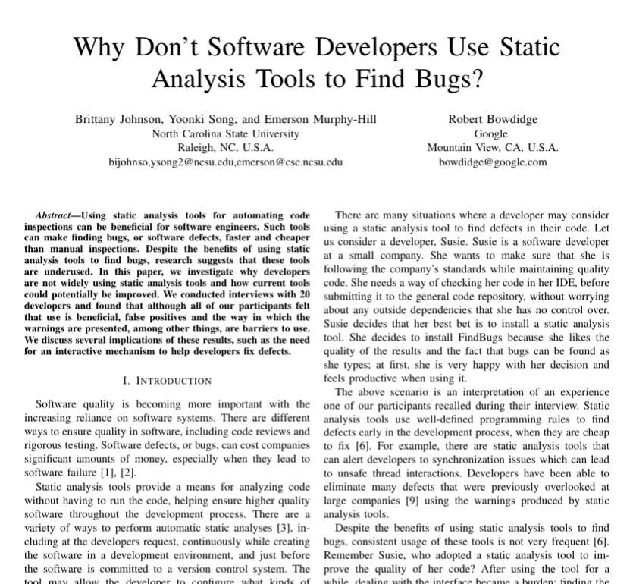
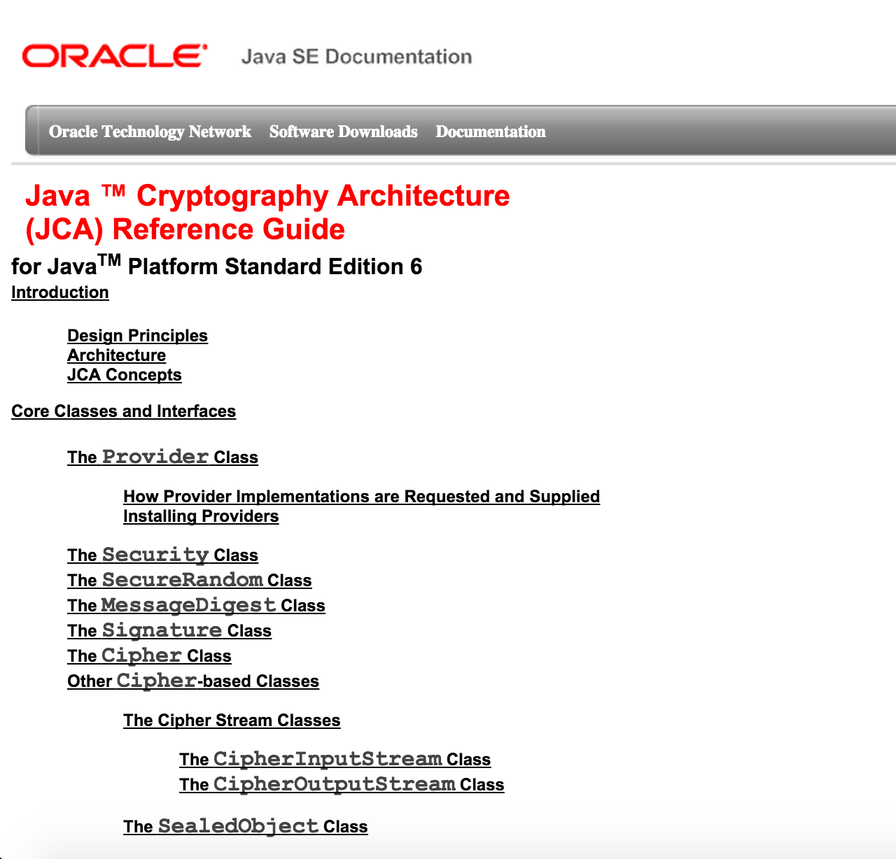
Existing solutions
Program analysis tools
Documentation
64 A4 Pages!!!
API usage patterns have variantions!!!
Notes:
So the two obvious solutions, is to provide good documentation. But even here the documentation is for the library and not for the tasks. Like password hashing or something. And we also know developers don’t really like reading documentation. And the other solution is to have specific static analysis and ship it with the library itself. But static analysis is full of false positives and api usage patterns evolve and are variant for different contexts like what is good for android 10 is not good for 11, or what is good In Germany is not good in USA or the other way around.

Slide 6
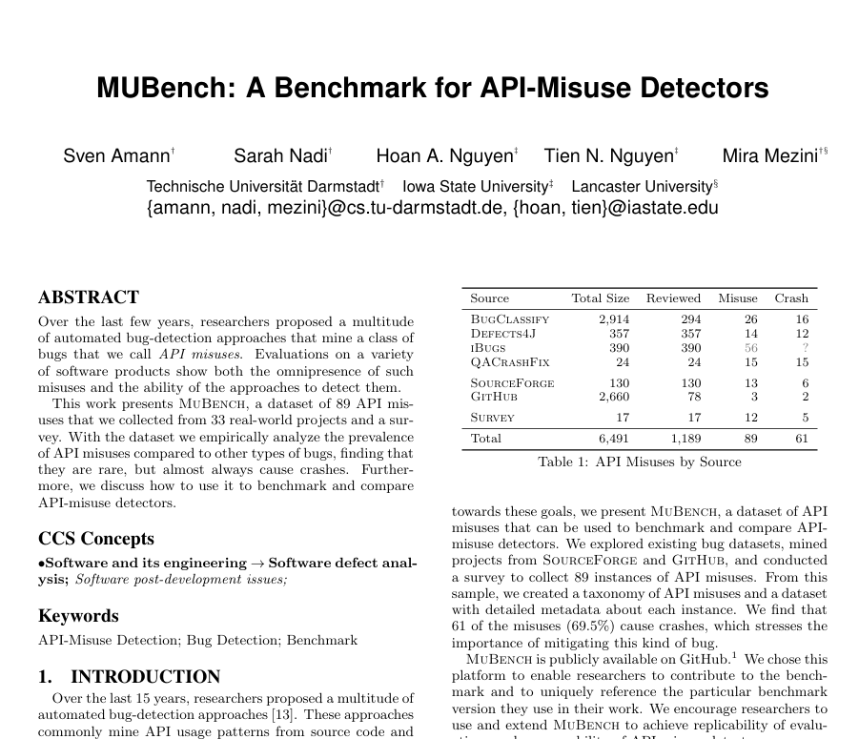

Common misuse types
Incorrect call sequence
Insecure parameters
Insecure composition
Notes:
SO before I jump and discuss the DSL itself, I mentioned I will narrow the scope. So for the DSLs I will discuss today, I will focus on three main categories of misuses. They are quite obvious actually. But they are not out of thin air. There is this large scale brnchmark for API misuse detectors where they looked at what sort of misuses happen in practice. They are essentially entry points to your method and how you can use them in what order etc.

Slide 7

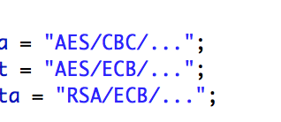

„Insecure Parameter“
Block mode missing
String to select block mode and padding scheme
Block mode ECB is unsafe
Notes:
This one is simple. Essentially unintended parameter that type checks.

Slide 8
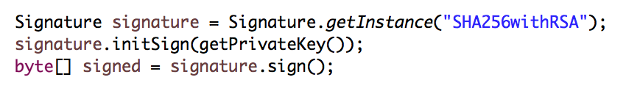
„Incorrect call sequence“
Notes:
The next kind is wrong order of method calls. Here for example, you need to update the signature with the data it needs to sign before you sign it. Kind of a null signature exception.

Slide 9
„Incorrect call sequence“
States of Signature Object
getInstance(String algorithm)
Constructed
initSign(PrivateKey key)
Initialized with PrivateKey
update(byte[] data)
Updated with data for signing
update(byte[] data)
sign()
Signature computed
Notes:
This whole category can be visualized as a state machine. Each method call puts your program in a new state and when you bump into a state that is not allowed, it is a misuse.

Slide 10
„Incorrect call sequence“
States of Signature Object
getInstance(String algorithm)
Constructed
initSign(PrivateKey key)
Initialized with Privatekey
sign()
update(byte[] data)
Data not signed
update(byte[] data)
sign()

Slide 11

Insecure Class Composition
getInstance(String algorithm)
getInstance(String algorithm)
Constructed
initSign(PrivateKey key)
keySize = 64
Initialized with Private Key
Insecure Private Key
update(byte[] data)
Updated with Data for Signing
update(byte[] data)
sign()
Insecure Signature
Signature Computed
Notes:
Class composition is similar but involving multiple objects. Here a private key needs to be of a particular size for it to be signed. This key size restriction is more relaxed with other uses.

Slide 12
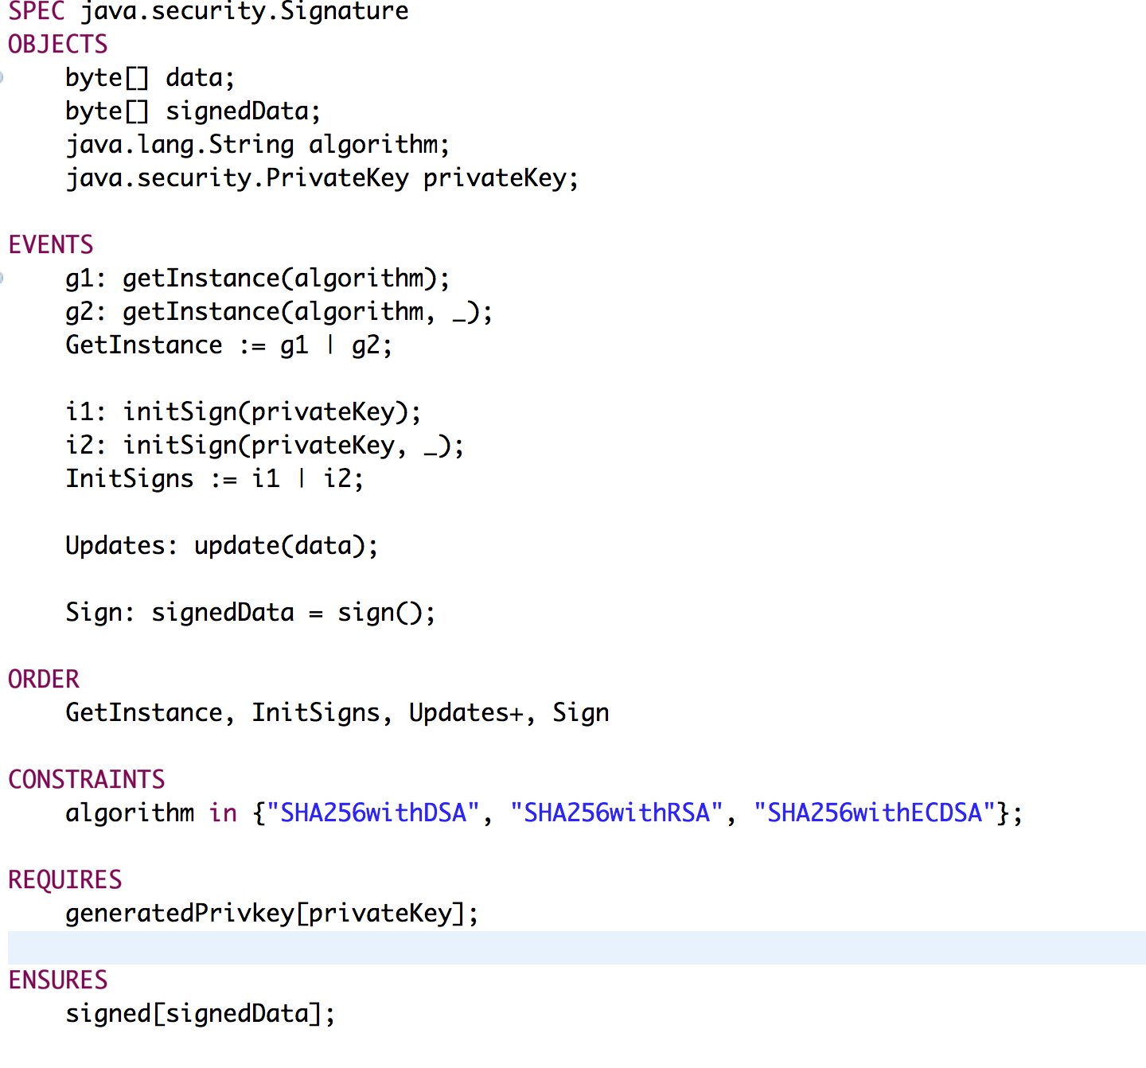
DSLs to the resue - CrySL
[CrySL: An Extensible Approach to Validating the Correct Usage of Cryptographic APIs. Stefan Kruger, Johannes Spaeth, Karim Ali, Eric Bodden, Mira Mezini. ECOOP 2018.]
Notes:
Now that we saw the kind of misuses, the DSL kind of comes out of itself. There is one specification per type, As mentioned before todays focus is not this particular DSL. But it is a good place to motivate the dynamic DSL work. This is the declaration area where you specify:
What object type do you want to analyse
What are the inputs and parameters you use in your analysis
What events are there, can be grouped

Slide 13

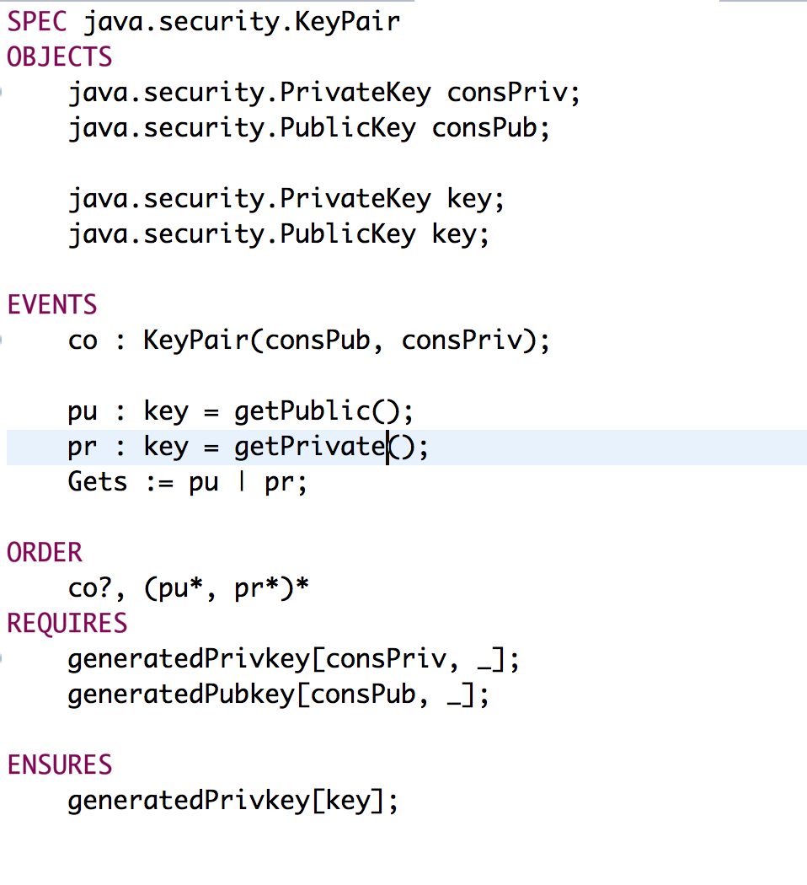
DSLs to the resue - CrySL
[CrySL: An Extensible Approach to Validating the Correct Usage of Cryptographic APIs. Stefan Krüger, Johannes Spaeth, Karim Ali, Eric Bodden, Mira Mezini. ECOOP 2018.]
Notes:
Now here you have sort of one or two sections per misuse type.
Constraints for first kind of error
Order for second kinf, creating state machines. This is essentially regular expression.
Requires and ensures also connect the dots on which objects are used in what form

Slide 14
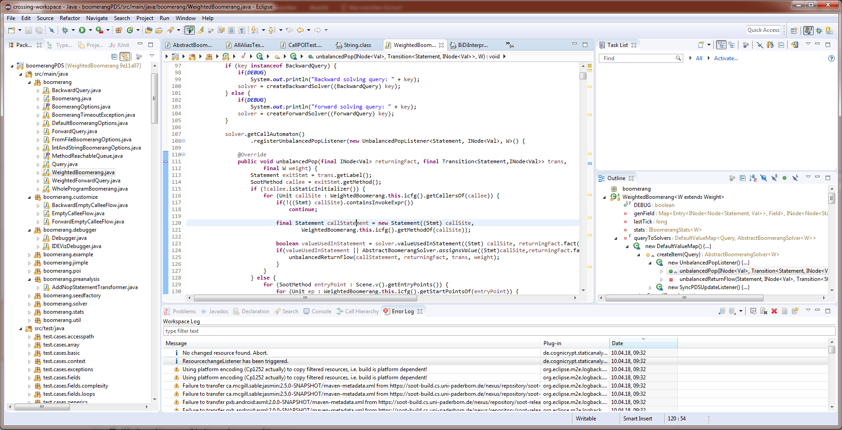
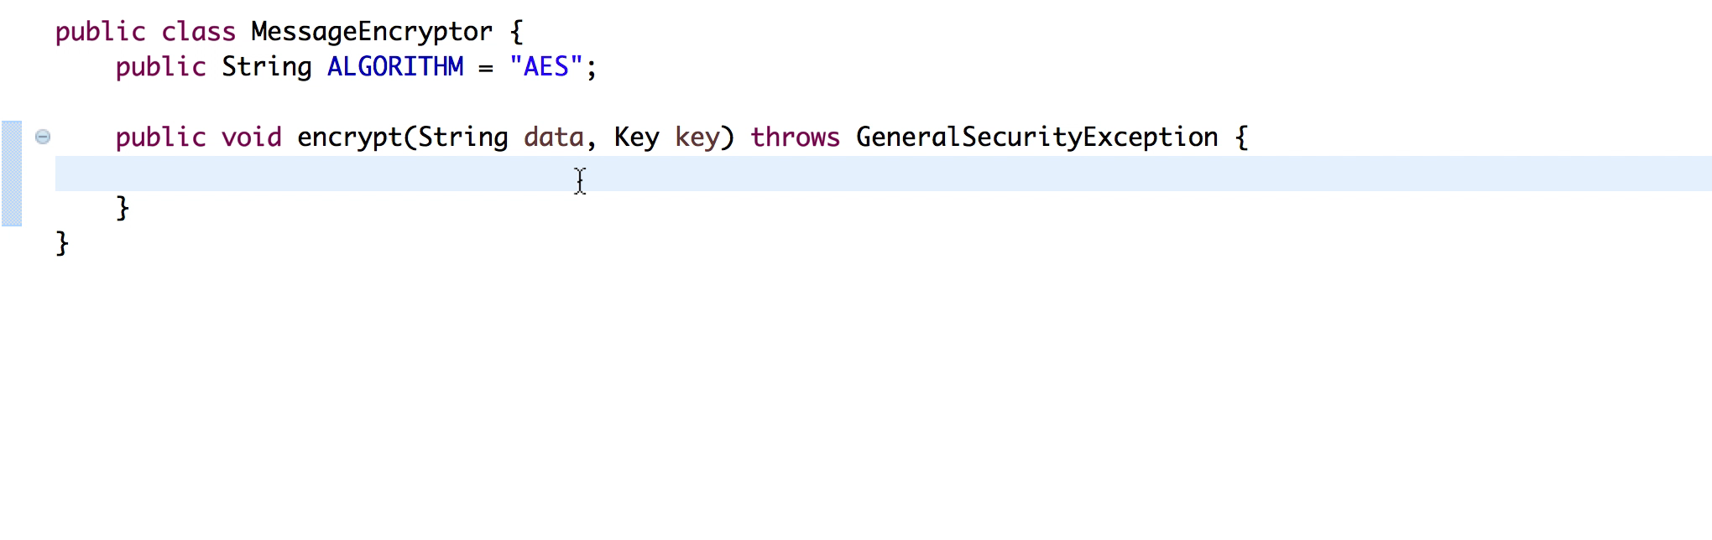

Demo: CrySL based static analysis
Notes:
The issue here is the insecure defaults.

Slide 15
Issues with CrySL
Not all misuses are detectable statically
Example: Iterator.hasNext() should return true before a valid call to next()
Still requires external static analysis tools
Also, false positives!!
Notes:
Here is how the next 15 mins or so looks like. The main goal of these slides is mainly to narrow the scope of discussion on API misuses (which can be quite broad as a topic) before we see the DSL in action. As you can see here there are actually a couple of DSLs. The static one was already first version complete by a PhD student. I built an MPS editor for it with a bachelor student which I will show today. I also worked on some extensions to it. But today I will mainly focus on the dynamic DSL part for the demo.

Slide 16
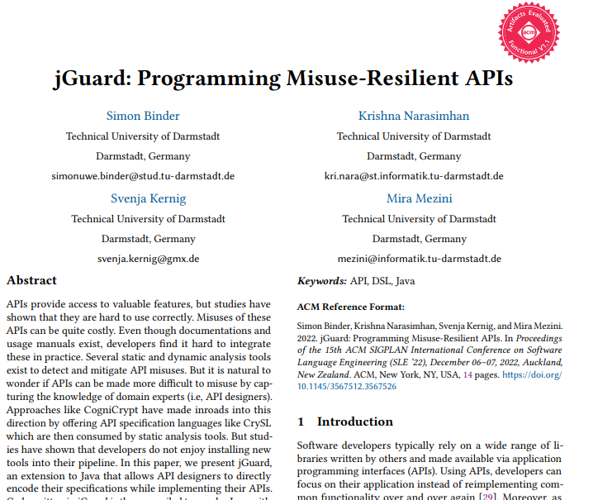
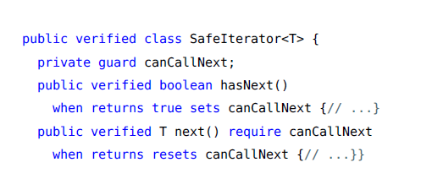
jGuard
jGuard compiles to regular java
APIs become resilient by design
Primary DSL concepts:
Guards
Requirements
Consequences
Notes:
A simple example is iterator.hasNext
SO here the idea is that you secure your API by design. So this is an extension in base language. And it compiles to regular java with the checks in lined. The flow is quite simple. If we recollect, we can model most API usage patterns as state machines. You use guards to express states. And for every state change you can react in your methods. And in your method signature, you have requirements which are pre conditions that should be satisfied before your method is called. And you have what we call consequences which change some states. And the requirement can be any Boolean expression and make use of the parameters of the method. I will show you how this looks like in the demo.

Slide 17
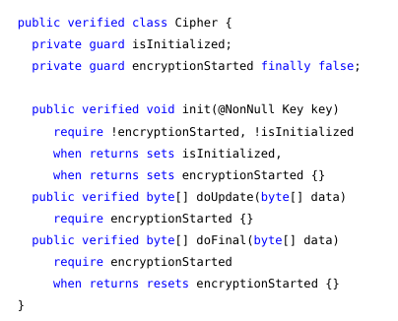
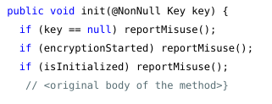
jGuard – Generated code requirements
Notes:
A simple example is iterator.hasNext
This work was published at SLE 22 where coincidentally Jos also presented Freeon.
SO here the idea is that you secure your API by design. So this is an extension in base language. And it compiles to regular java with the checks in lined. The flow is quite simple. You use guards to express states. And for every state change you can react in your methods. And in your method signature, you have requirements which are pre conditions that should be satisfied before your method is called. And you have what we call consequences which change some states. And the requirement can be any Boolean expression and make use of the parameters of the method. I will show you how this looks like in the demo.

Slide 18
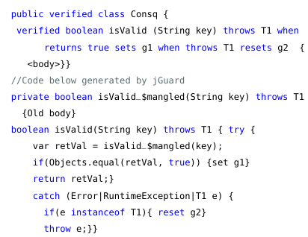
jGuard – Generated code consequences
Notes:
A simple example is iterator.hasNext
This work was published at SLE 22 where coincidentally Jos also presented Freeon.
SO here the idea is that you secure your API by design. So this is an extension in base language. And it compiles to regular java with the checks in lined. The flow is quite simple. You use guards to express states. And for every state change you can react in your methods. And in your method signature, you have requirements which are pre conditions that should be satisfied before your method is called. And you have what we call consequences which change some states. And the requirement can be any Boolean expression and make use of the parameters of the method. I will show you how this looks like in the demo.

Slide 19
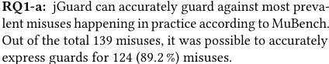
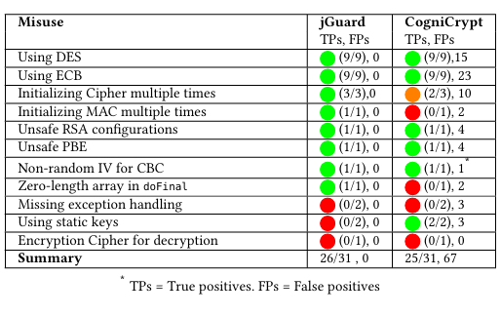
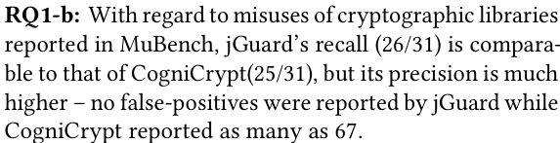
jGuard – Evaluation expressivity
Notes:
A simple example is iterator.hasNext
This work was published at SLE 22 where coincidentally Jos also presented Freeon.
SO here the idea is that you secure your API by design. So this is an extension in base language. And it compiles to regular java with the checks in lined. The flow is quite simple. You use guards to express states. And for every state change you can react in your methods. And in your method signature, you have requirements which are pre conditions that should be satisfied before your method is called. And you have what we call consequences which change some states. And the requirement can be any Boolean expression and make use of the parameters of the method. I will show you how this looks like in the demo.

Slide 20
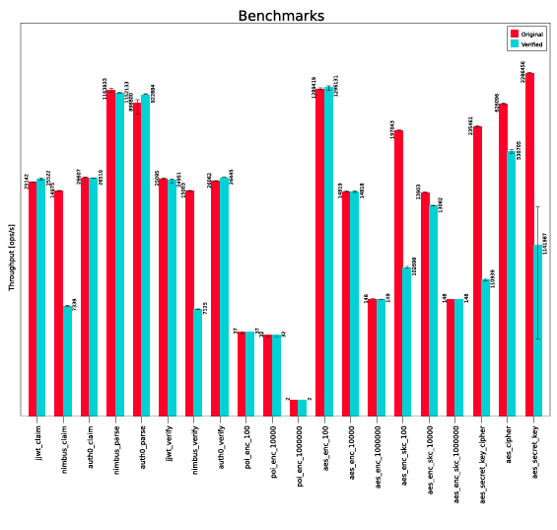
jGuard – Evaluation performance
RQ2: jGuard introduces little performance overhead.
Notes:
A simple example is iterator.hasNext
This work was published at SLE 22 where coincidentally Jos also presented Freeon.
SO here the idea is that you secure your API by design. So this is an extension in base language. And it compiles to regular java with the checks in lined. The flow is quite simple. You use guards to express states. And for every state change you can react in your methods. And in your method signature, you have requirements which are pre conditions that should be satisfied before your method is called. And you have what we call consequences which change some states. And the requirement can be any Boolean expression and make use of the parameters of the method. I will show you how this looks like in the demo.

Slide 21
Demo

